Slide 1
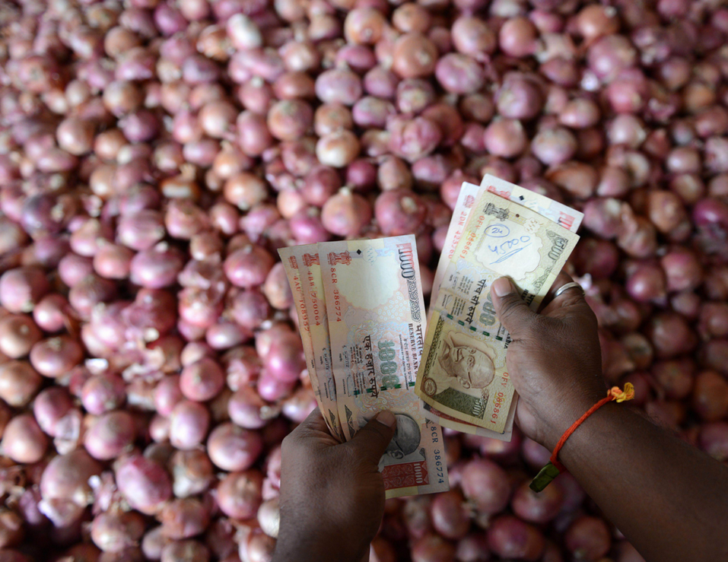
Inflation Theory
Index Theory
Inflation Indexes
Production Indexes

Slide 2
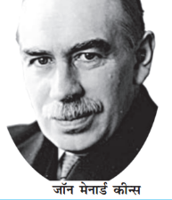
@full employment (ignore voluntary & Frictional)
Aggregate Demand (C+I+G)+(X-M)
Consumption
Investment
Govt.
Purchase
J.M.Keyenes (UK, 1883)
“General Theory on employment, interest, money”
Full employment can happen only with Government spending on public works (Roosevelt’s Hoover dam, UPA’s MNREGA)
GENERAL PRICE LEVEL
Aggregate Supply
Total output by all firms

Slide 3


Excess demand ► Inflationary gap
Aggregate Demand (C+I+G)+(X-M)
Aggregate Demand (C+I+G)+(X-M)
Inflationary Gap
“Demand Pull”
Consumption
Investment
Govt.
Purchase
Reasons: when ▲
Money supply: Propensity to consume, Investment expdr.
Fiscal deficit
Export
GENERAL PRICE LEVEL
Aggregate Supply
Total output by all firms
Already @full employment, so can’t increase production further, so there will be general rise in prices of goods and services= inflation.
Homework: think of “supply-side / Cost-push” inflationary gap”
Notes:
24% hike by 7th PC
PM Uijawaala

Slide 4
UPSC ‘s CDS-2012-I
To combat inflationary pressure, what should be done?
Increase direct taxes
Reduce interest rates
Increase public Expenditure
Choices:
A): Only 1 ; B): Only 2;
C): Only 2 and 3; D): only 1 and 2
Then “C” and “I” will increase ☹
Hint: Agg. Demand = Consump. + Investment + Govt Purchase + eXport – iMport

Slide 5
Deficient Demand ► Deflationary Gap
Aggregate Demand (C+I+G)+(X-M)
Aggregate Demand (C+I+G)+(X-I)
Reasons: when
▼ Money supply
▲Propensity to SAVE;
▼Investment expenditure
▲ Fiscal consolidation
▲ Import
Deflationary gap
Consumption
Investment
Govt.
purchase
GENERAL PRICE LEVEL
Aggregate Supply
Total output by all firms
Notes:
Solution – tax?

Slide 6

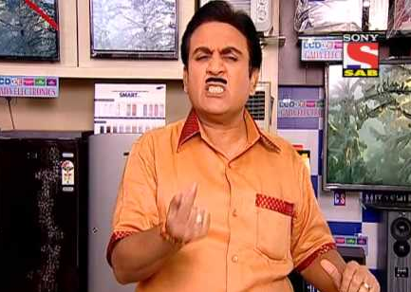
Best LCD TV. You’ll not get better price than this!!....buy it now!
No no…I’ll wait for the prices to drop even further….
Aggregate Demand shrinks even further
Aggregate Demand
Aggregate Supply
Total output by all firms

Slide 7
Deflationary Gap► Deflationary spiral
Agg.Demand ▼
even further = deflationary gap ▲
Aggregate Demand (C+I+G)+(X-I)
Deflationary gap
Consumption ▼, Savings ▲
Demand, profitability ▼
Unemployment ▲
Bankruptcy, NPA ▲
Consumption
Investment
Govt.
Demand
GENERAL PRICE LEVEL
Aggregate Supply
Total output by all firms
Notes:
https://books.google.co.in/books?id=MJsJDKexrTcC&pg=PA282&dq=deflationary+spiral&hl=en&sa=X&ved=0ahUKEwjglqqH7o3OAhWHK48KHQRyDOgQ6AEIKDAC#v=onepage&q=deflationary%20spiral&f=false

Slide 8
Mock MCQ
Find correct statement
Deflationary spiral is a chain of events that worsen the deflation
Inflationary spiral is a chain of events that worsen the inflation.
Both A and B
Neither A nor B

Slide 9
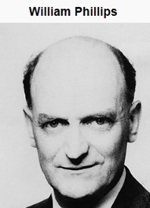





Philip curve
मेंहगाई बढ़ेगी तो रोजगारी बढ़ेगी
मेंहगाई कम होगी तो बेरोजगारी बढ़ेगी
Inflation
But in the long run, it’ll be come Verticle i.e. “natural rate of unemployment” irrespective of inflation
unemployment

Slide 10


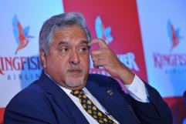


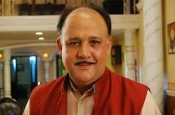
Philip Curve: inflation ∝ 1/ unemployment
But Stagflation: inflation & unemployment both ▲
Reflation:
Using fiscal | monetary policy
Inflation
Cost-Push
Demand-Pull
Monetary
General Price Level
Deflation
Rate of inflation
Creeping (single digit)
Walking
Galloping (double digit)
Hyperinflation (max. RGSLLY in Germany)
inflation favors the debtor over the lender. Recall nominal vs. real interest.

Slide 11
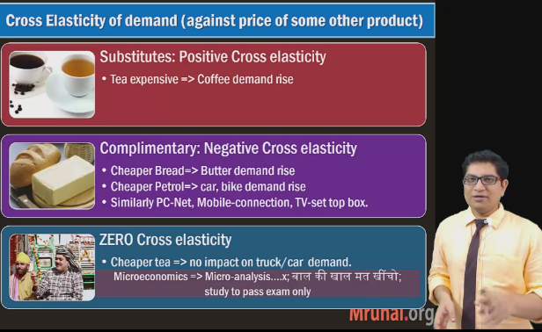
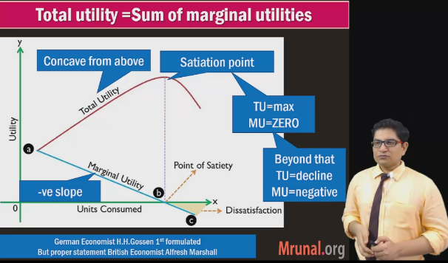
Price, supply, demand & elasticity: Micro economics self study

Slide 12
Inflation Theory
Index Theory
Inflation Indexes
Production Indexes

Slide 13



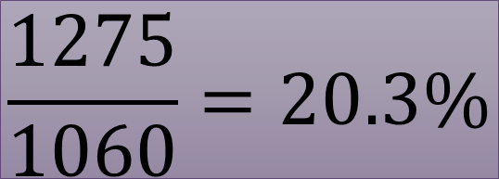
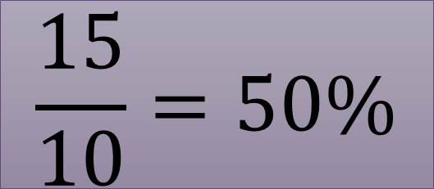

2012
2017
$$\frac{15}{10}=50\%$$
10
15
50
60
But are all commodities
bought in same quantity
and frequency every day?
1000
1200
$$\frac{1275}{1060}=20.3\%$$
1060
1275
$$Inflation=\frac{Price in Current Year}{Price in Base year}$$

Slide 14



Weight | Base Year 2012 | Current Year 2017 | Price ratio (‘17/’12) | Ratio x weight
30 | 10 | 15 | 1.5 | 45
60 | 50 | 60 | 1.2 | 72
10 | 1000 | 1200 | 1.2 | 12
100 | --- | --- |  | 129
$$Inflation=\frac{129}{100}=29\%$$

Slide 15
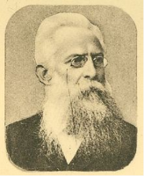
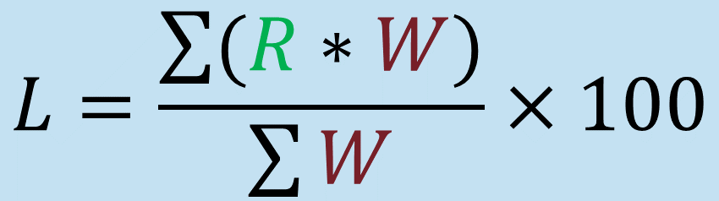


Inflation (even production): Laspeyres formula (German)
$$Where \text{"}\text{R}\text{"}=\frac{Price in current}{Price in Base year}$$
$$L=\frac{\sum{(R∗W)}}{\sum{W}}×100$$
$$Where \text{W}\text{=}\text{weight} \text{assigned} \text{to}$$
$$\text{each} \text{commodity}$$
Price indexes
German economist: Laspeyer’s index.
German economist: Hermann Paasche's Index
American economist Irving Fisher's index: "ideal" price index, because it's 'geometric avg' of above two'.

Slide 16
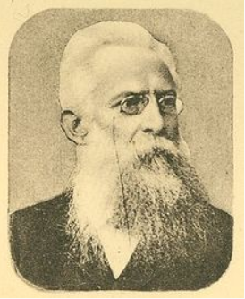
Calculating inflation & production
Index | Base Year | Who?
CPI | 2012 2010 | CSO
WPI | 2011 2004
IIP | 2011 2004 | CSO
GDP | 2011 | CSO
Laspeyres
Earlier base year was 2010, but updated in 2015
Earlier base year was 2004, but updated in 2017
Eco. Advisor, DIPP
Earlier base year was 2004, but updated in 2017
NOT Laspeyres
Notes:
National Sample Survey Office

Slide 17

MOSPI (1999)
Statistics
Program implementation
CSO [Chief Statistician TCA Anant, Prof. @DU. ]
NSSO [sample survey office]
National Statistical commission:
1 part time chairman, 4 part time member [NITI Secretary is ex-officio).
2005. cabinet resolution. on Rangarajan’s advise
MPLADS & 20 pt program (2006):
Infra projects monitoring.
<BES17”5”:Infra: more in rural Development lecture>
IYB: Ch.6 Basic Economic Data

Slide 18
Collection of Statistics Act
2008: Govt appoints statistical officers for social, economic, demographic, scientific and environmental data.
Others are bound to give data e.g. WPI data: factory owners must provide data to DIPP.
2017 amendment: applicable to J&K as well.

Slide 19

Inflation Index #1: Consumer Price Index (CPI)
MOSPI: CSO
Industrial Workers (IW)
2001=100
Rural Labourers (RL)
1986-87=100
Agricultural Labourers (AL)
1986-87=100
Rural
Urban
All India
Rural Urban combined
2012
2012
RBI’s MPC targets:
CPI (All India): 2-6%
Notes:
Labour Bureau, Chandigarh/Shimla is engaged in collection, compilation, analysis and dissemination of labour statistics at all-India level on different facets of labour, such as, employment, wages and earnings, strikes and lockouts, absenteeism, labour turnover, labour cost, working and living conditions of workers, etc., both in organized and unorganized sector of industries. It also constructs, maintains and publishes Consumer Price Index Numbers for :
(i) Industrial Workers (Base 2001=100)
(ii) Rural Labourers (Base 1986-87=100)
Agricultural Labourers (Base 1986-87=100).

Slide 20





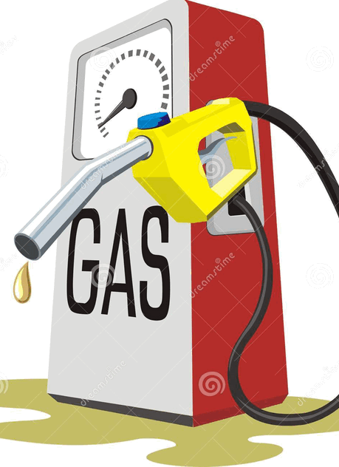



CPI (Base 2012, CSO)
CPI
Rural
Urban
ITEMS
448
460
CPI: 6 components Descending weight
Food, Beverage
~50% wt
Misc.-Health, Edu, Recreation, transport etc. “SERVICES”
Housing
N/A in rural
Fuel & LIGHT
~10%
Entire
Minus
Food & Fuel
Remainder
CORE Inflation (wt.42.9%)
Headline inflation
Clothing,
Footwear
Pan, Tobacco,
Desi intoxicants
CFPI
Consumer food price index
Notes:
Core CPI=
Headline CPI
Minus (food & fuel)

Slide 21
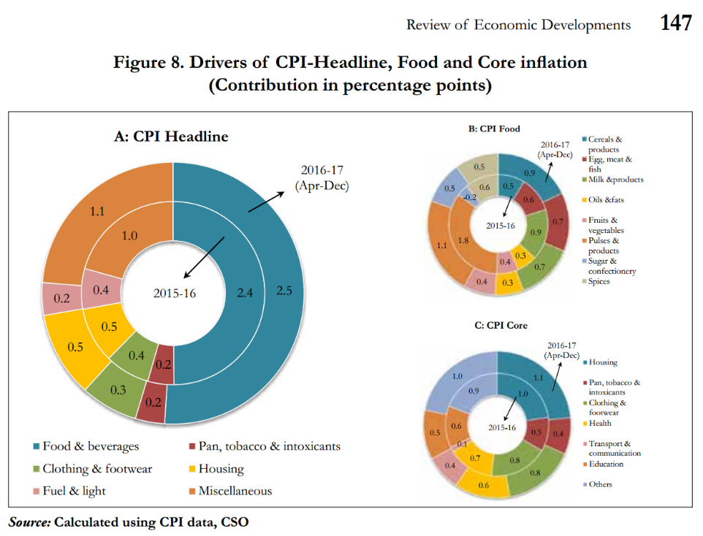
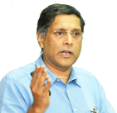
Since I’ve to fill up 300 pages, so I’ll paste a chart and describe it for in text for 5-7 pages.
Food is major driver of inflation
Within food, PULSES
Within “CORE”: housing & transport

Slide 22
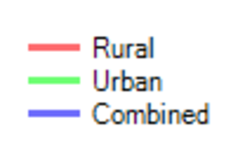
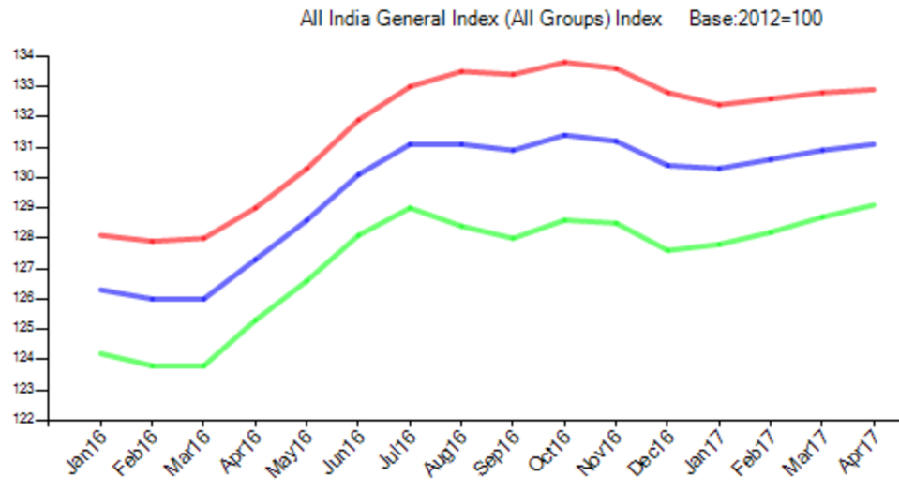
Why “wedge” between Rural and Urban CPI
Rural: More wt. to cereal, pulses
wedge
Demonetization
Dropped, then stabilized & increased
Urban: When crude down, transport cheaper..
Notes:
http://164.100.34.62:8080/Chart%20All%20India%20General%20Index_2012.aspx

Slide 23




CPI (Base 2012, CSO calculates)
Demonetization
Projection for next year
Good monsoon, better sowing, govt schemes = Food inflation down
Crude oil up
CPI = ~5%
Core inflation “Sticky”: “TRANSPORT” (fuel) and Housing

Slide 24
base effect
110
10%
As such only +10 pts increase than previous year.
But depending on the inflation in the comparison year, the % varies
100
120
9.09%
110

Slide 25
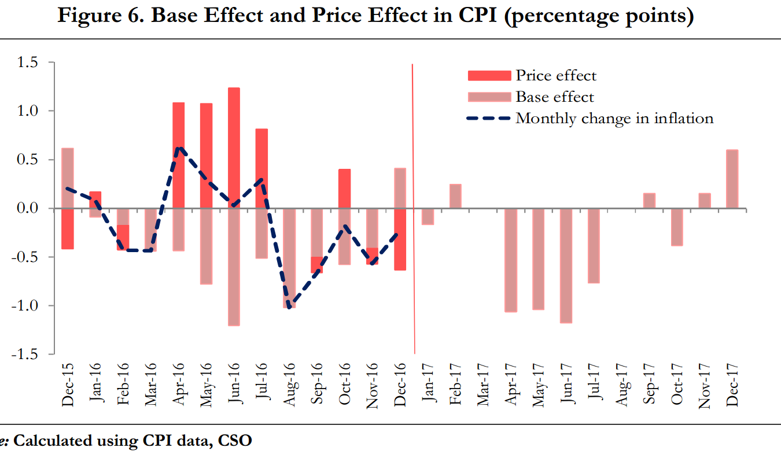

CPI rise for 1) price effect of global com2) adverse base effect
Since I’ve to fill up 300 pages, so I’ll paste a chart and describe it for in text for 5-7 pages.

Slide 26
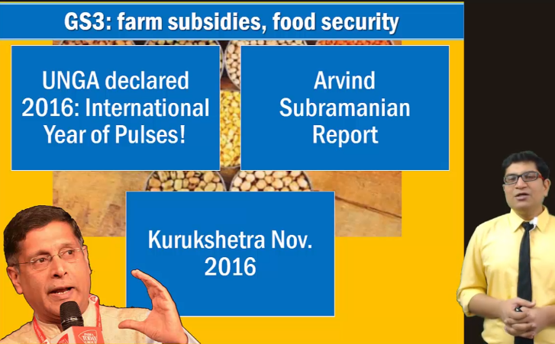
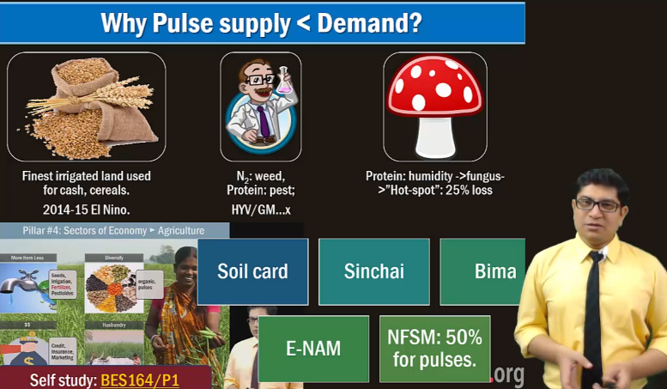
Self study: pulses report hardly 12 minutes ML16: GSM3/Agri

Slide 27
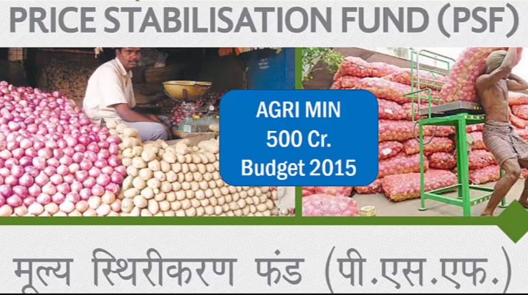
Price stabilization Fund & Pulses Report
Union gives interest free advance to states for onion, potato …Pulses purchase
2016: Agri-> consumer affairs ministry transfer
Notes:
Actual March end 2015.
500 crores
Price Stabilization Fund Management Committee (PSFMC)
Chairman: Secretary of Agri. department
Interest free Loan to union and state agencies as “working capital”
Buy perishable agro. From farmers
Sell cheap @end user
Initial focus onion potatoes.
States to setup their own funds- contribution 50:50 (Gen.), 75:25 (NE)

Slide 28
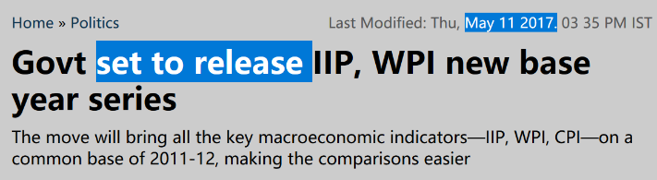
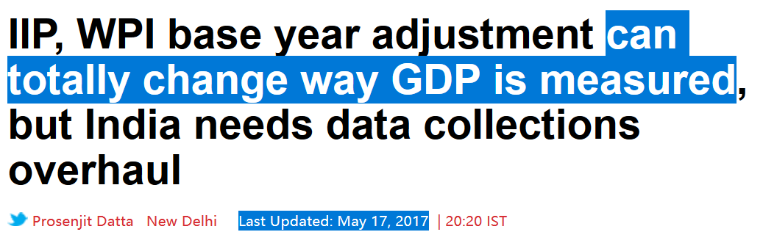
Inflation theory, index theory, CPI
WPI and IIP: ‘basket and base year’ changes- news came in Week2 of May 2017.
These updates I’ve put in “PINK BOXES”. @ UPSC prelim 2017-walla may ignore it. [Mains-2017 not asked, but interview-2017 may asked]
MCQ Exams after June 2017: SSC-CGL, CAPF etc. should prepare it.
Notes:
http://www.businesstoday.in/opinion/prosaic-view/iip-wpi-base-year-adjustment-can-totally-change-way-gdp-is-measured-but-india-needs-data-collections-overhaul/story/252391.html

Slide 29
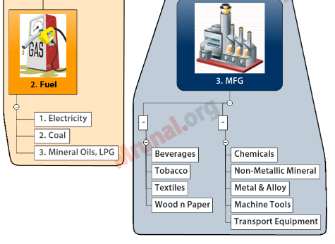
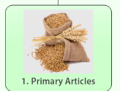
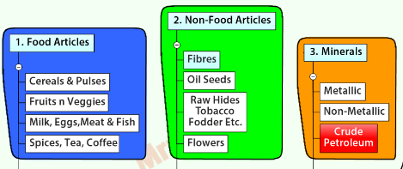
1st index CPI over…now 2nd Index Wholesale Price Index..
WPI
category1
category2
category3
Before: separately compiled as per usage in agri, industry, domestic etc.
After: Data compilation as a Single item.

Slide 30


WPI: Eco Advisor, DIPP, Base year 2004=100
2011=100
Pink boxes
= New “series” from May 2017
WPI components WEIGHT
64%
MFG. (65%)
Chem
Metal
Food
Top 3 sub-weight (DECREASING)
23%
PRIMARY (20%)
Food
Non-food
Mineral
13%
~24%
Fuel (15%)
Oil
Electricity
Coal
Entire
Minus
Food & Fuel
Remainder
CORE Inflation
Headline inflation
"WPI food index" computation separately using them. So, Along with CFPI by CSO, they'll help better monitoring of food inflation.

Slide 31
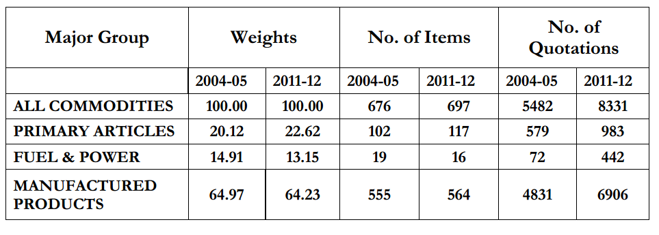
For answering Interview: what changes have been done in WPI basket, series and calculation method?
Updated the Item list and weights assigned to the three categories.
Indirect taxes will not be counted = ~ to 1st world countries PPI= Captures price change from seller’s perspective. IMF had recommended. (OR MAY BE to prove GST is not cause of inflation!)
WPI Food index will be declared separately, just like CSOs CFPI.
▲item#
135 Old removed,
173 new added

Slide 32
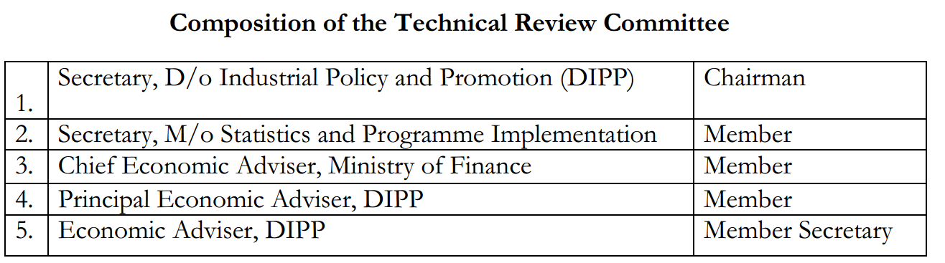
WPI reform-2017- technical review committee (TRC)
Urjit Patel Committee: MPC for monetary policy.
Dr. Soumitra Chaudhuri (Ex-planning commission member, 2012): TRC. For WPI
Meet atleast once a year.
Meet atleast once a year, add/remove/tweak item list, weights, data collection, calculation method etc.

Slide 33
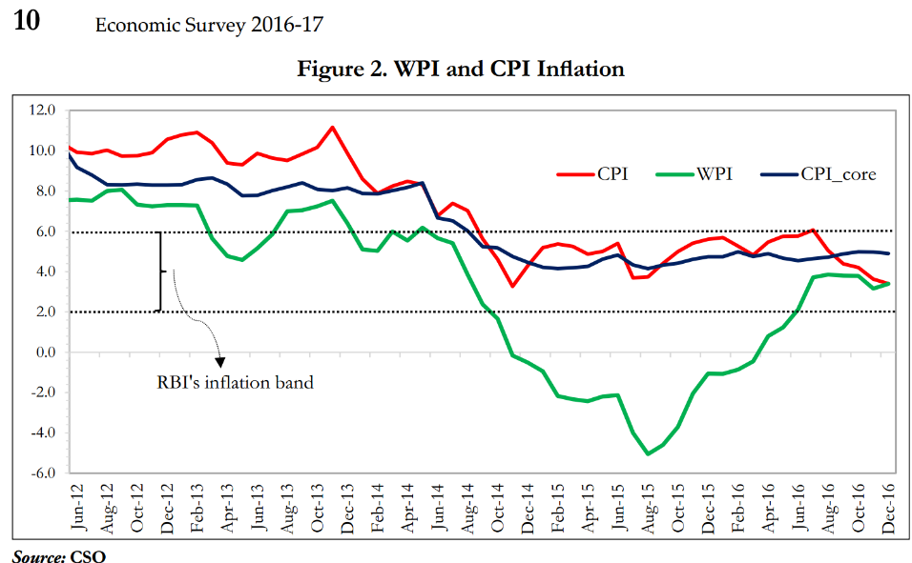
Different base years and
Food
CPI: more weight to food items- and was high because of pulses, El Nino, 2 drought years.
ENERGY [2015]
WPI: Crude oil down
CPI: firewood, electricity etc given more weight.
Goods [2015]
Intl. commodity prices down post China breakdown.
SERVICE
WPI: doesn’t count. But CPI counts.
WEDGE

Slide 34
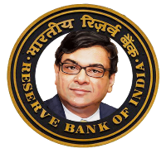
Inflation theory, Index theory, inflation index 1) CPI 2) WPI. Inflation measurement: other indexes
PPI: Producer’s price index
PPI: Both goods and services, but not TAXES
Banking Business Service Price by RBI, since 2004
WPI: [Only goods + Taxes + APMC Levies] [!!ref pink box for update!!]
Price change from Sellers’ perspective. Most OECD use. IMF wants India to use this, so more accurate GDP deflator. 2014: CSO setup BN Goldar Committee
Direct services: DD, NEFT, cards etc. “service charge”
“intermediation services”: deposit and loan ops. “spread”

Slide 35
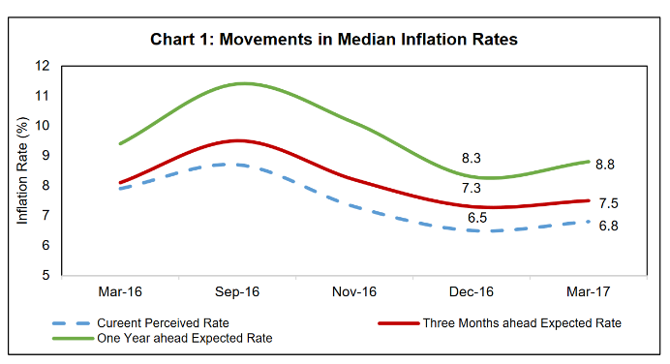
Inflation measurement: other indexes
Inflation expectation survey for households by RBI, since 2007
RESIDEX by NHB (100% RBI owned), since 2007
~5k households across 18 cities. Since 2005
Housing prices in 26 cities.
2017, March: planning to revamp, add new index like Rental Index, Construction Material Index.
For 3 months, 1 year.
Notes:
https://rbidocs.rbi.org.in/rdocs/Publications/PDFs/IESH0603201701872E6E72E847699C0DA2DB176BBAC1.PDF

Slide 36
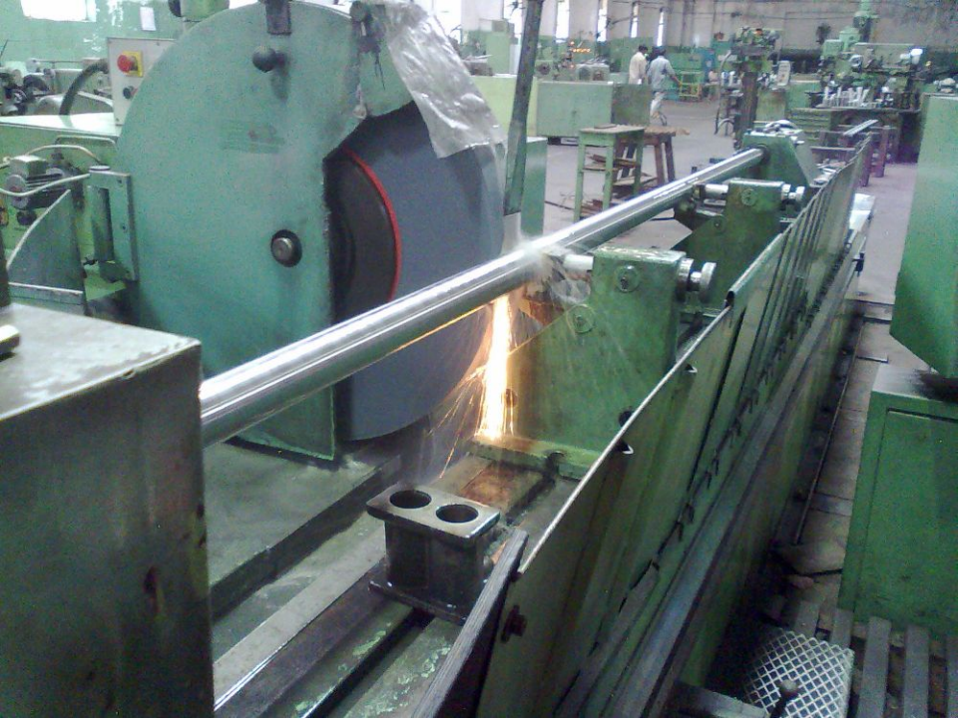
Inflation Theory
Index Theory
Inflation Indexes
Production Indexes
Measuring Production

Slide 37
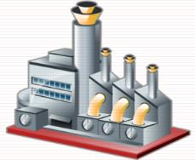
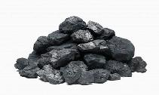
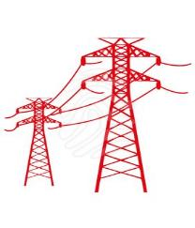
Index of Industrial Production (IIP), CSO, Base year 2004
2011=100
78%
Pink boxes
= new series launched in may 2017
Before: 620 items in 397 gr. After: 809 items in 405 gr.
14%
8%
MFG: 76%
Renewable sources data will also be captured.
Mining: 14%
Electricity: 10%

Slide 38
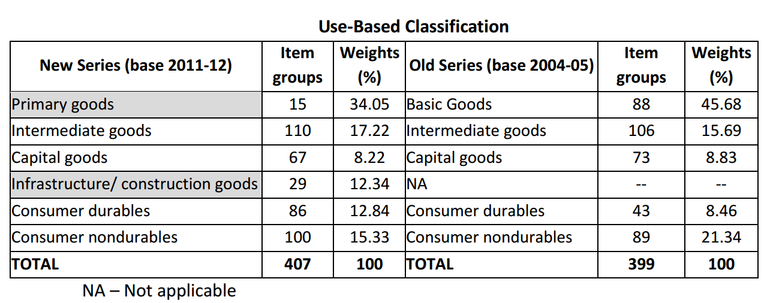
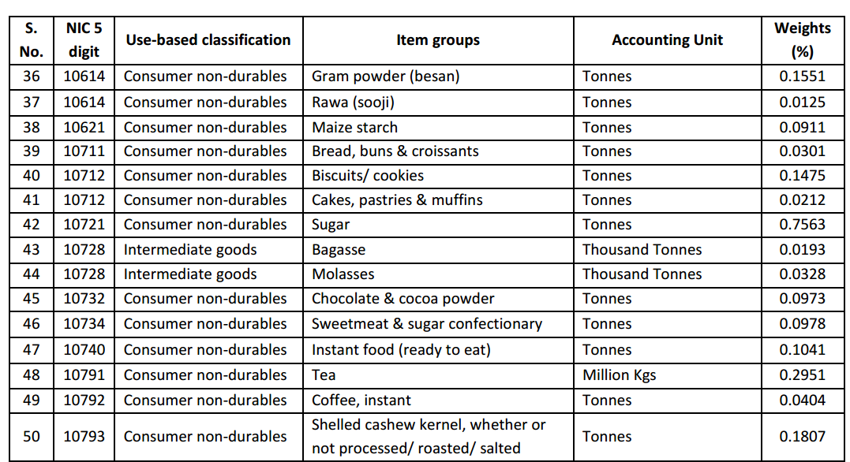
IIP: “use” base classification of industries
National industrial classification (NIC)
Similar to WPI: technical review Committee, here also one TRC under Secretary, MOSPI.
Meet atleast once a year, add/remove/tweak item list, weights, data collection, calculation method etc.

Slide 39
Mock Question for Prelims
IIP measures the level of production in which of the following categories of goods?
Intermediate goods
Consumer non-durables
Consumer durables.
Capital goods
Answer choices
(a) 3 and 4 only
(b) 2 and 3 only
(c) 1, 3 and 4 only
(d) 1, 2, 3 and 4

Slide 40
IIP: 8 Core Industries (~38% weight in old series)
Growth During 2016-17
Infra NPA+TBS, high RESIDEX, unsold inventories, even after Demonetization ? ☹
Because crude oil import cheap
UDAY
Cheap to import
Notes:
http://eaindustry.nic.in/eight_core_infra/eight_infra.pdf

Slide 41
Mock Question for Prelims
Find correct statement
Both In WPI and CPI, there has been continuous fall during Q3-2016, on account of the demonetization.
Both in IIP and ASI, electricity generation has registered negative growth in 2016-17.
Both In WPI and IIP, mfg sector has been assigned the highest weight.
None of the above.

Slide 42
Apart from IIP: How to measure production / economic activity? any other indexes?
ASI: Annual Survey of Industries
All registered units of factories act, and electricity companies.
EXCLUDED: Defense, oil, hotel café, computer, technical training inst. and other Services
RBI’s OBICUS
Quarterly
Order Books, Inventories and Capacity Utilization Survey
RBI To assess consumption & investment demand
Surveyed but data not tabulated: Movie companies, personal service etc.
(MSOPI) NSSO collect-> CSO Process

Slide 43
Apart from IIP: How to measure production, any other indexes?
Service performance index (SPI)
Because IIP doesn’t cover. ASI covers partially.
CSO -> Prof. CP Chandrasekhar.
SBI’s Composite Index (since 2014)
Baltic Dry Index by London’s Baltic Exchange
HSBC’s Purchasing Manager Index (PMI)
<50= economy contraction ; >50=Economic growth
Based on loan portfolio, inflation etc.
▲ = world economy to grow
▼ = economy to slowdown
Cost to transport raw material by sea
Planned but no updates post-2015?

Slide 44
Mock Question for Prelims
RBI prepares which of the following indexes?
Banking Business Service Price index.
Order Books, Inventories and Capacity Utilization Survey
Inflation expectation survey for households
Answer Choices
a) Only 1 and 2 (b) Only 2 and 3
c) Only 1 and 3 (d) all of them

Slide 45
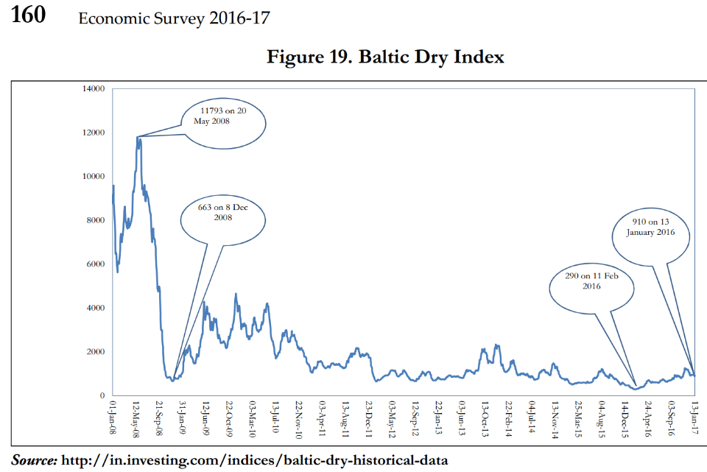
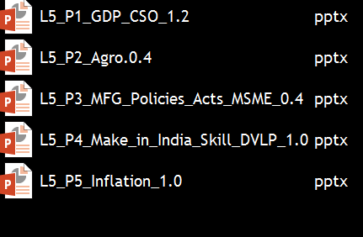
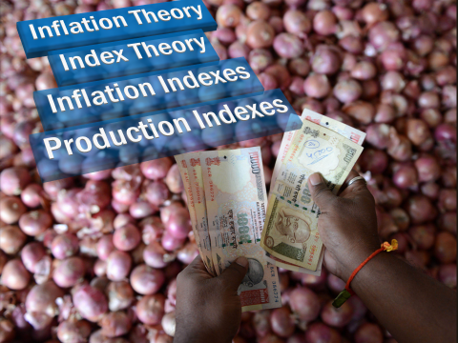
Fell post subprime crisis, now recovering…
OLD material “DEMONETIZED”

Slide 46


Economy: 6 pillars + theory + current + BES17 (pre cum Mains)
1.Banking, Fin, Insur.
6.HRD
2.Budget
3.BoP
4.Sectors
5.Infra
V1:c3,4
V1:c2,3, 6,9,11(GST),13
V1c:5
V1c:7(Textile),11(trade)
V1c:10
v1c:12, 14; Budget^Rail

